Slide 1


AI-Powered Mental Wellness Assistant for Women
A distributed, AI-driven digital assistant supporting women's mental wellness by addressing personalized emotional needs.
DATA 236 – Distributed Systems Project
Team: Drashti Bhingradiya (Lead), Divya Thakar, Devanshee Vyas, Khush Patel, Yashwanth Katipally, Keerthika Loganathan
Notes:
1.7.2013
1
‹#›

Slide 2


The Problem: Mental Wellness Gaps
Rising Mental Health Concerns
Generic Solutions
Critical Shortcomings
Existing mental wellness apps offer generic content without adapting to individual emotions or circumstances.
Current tools lack personalization and context-aware feedback, have minimal real-time analysis, poor integration of advanced AI insights, and remain inaccessible due to cost or cultural barriers.
Women face increasing stress, anxiety, and depression influenced by unique biological, social, and cultural factors.
There is an urgent need for a system that bridges the gap between static wellness content and dynamic, evidence-based mental health interventions.
Notes:
1.7.2013
2
‹#›

Slide 3
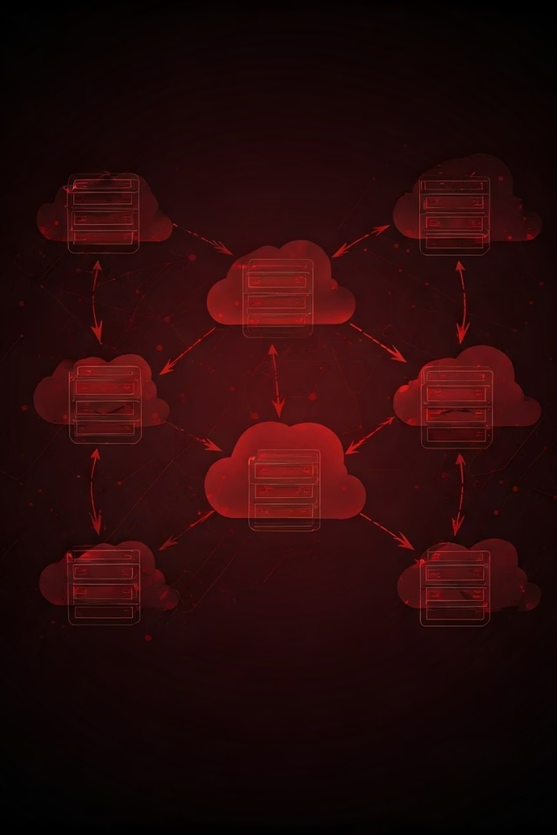





Relevance to Distributed Systems
Microservices Architecture
FastAPI‑based services for emotion detection, recommendation, and feedback.
Concurrent Processing
Addresses real-time data processing while serving multiple users simultaneously.
Cloud Infrastructure
Deployment via Docker, AWS EC2, and Kubernetes demonstrates practical distributed systems.
Distributed Systems Principles
Real-time processing, load balancing, and robust security measures are key concepts from DATA 236 applied in this solution.
Notes:
1.7.2013
3
‹#›

Slide 4
Scope & Problem Definition
Advanced NLP
Personalized Interventions
Scalable Backend
Fine‑tuned DistilBERT/RoBERTa models classify emotional states from text inputs.
Microservice-based system ensures high availability and responsiveness.
Guided mindfulness, journaling prompts
Notes:
1.7.2013
4
‹#›

Slide 5
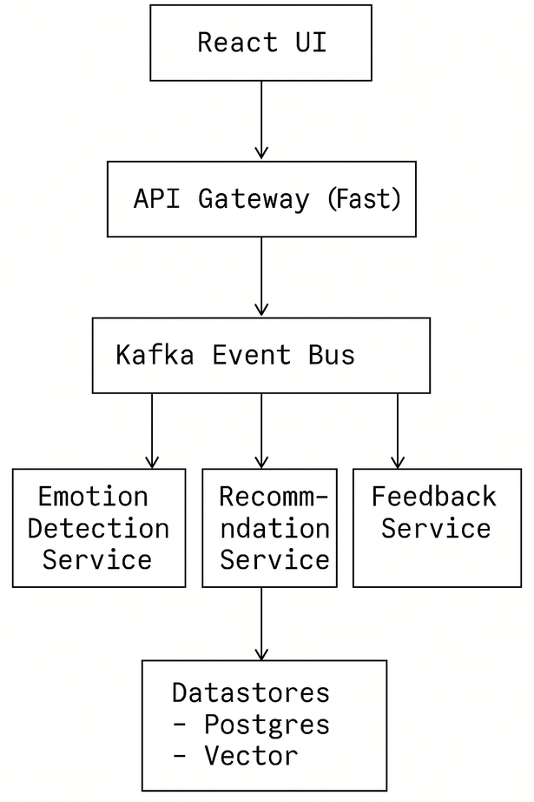
System Architecture Diagram
User Interface: React web app captures text/voice and shows recommendations.
API Gateway: Authenticates and routes requests to services.
Emotion Detection Service: FastAPI host running transformer inference.
Recommendation Engine: Maps emotions & history to curated content.
Feedback Service: Collects thumbs‑up/down and logs sessions to PostgreSQL.
Data Stores: Vector DB for embeddings; relational DB for profiles & logs.
Notes:
1.7.2013
5
‹#›

Slide 6








Key Differentiators & Why its Better
Adaptive Personalization
Tailored interventions that adapt with user history and context.
Women-Centric Design
Specifically addresses gender-specific stressors like hormonal changes and work-life balance.
Robust Scalability
Ensures scalability with real-time feedback through a distributed architecture, unlike static and rule-based apps.
1
Superior Real-time Adaptation
2
Enhanced Accuracy via Transformer Models
3
Robust scalability and Fault Tolerance
4
Focus on empathy and user privacy
Notes:
1.7.2013
6
‹#›

Slide 7
Hypothesis Testing Framework
Primary Hypothesis
Technical Hypothesis
AI-powered personalized interventions will reduce stress and anxiety levels compared to generic tools over four weeks.
The emotion classification model will achieve an F1-score of at least 85% on core emotional states.
Independent Variable: Intervention type
Testing Strategy: A/B testing with control group using generic app versus test group using AI assistant.
Dependent Variable: Stress/anxiety scores
Notes:
1.7.2013
7
‹#›

Slide 8
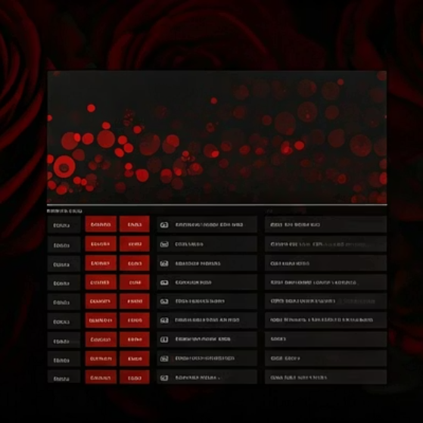
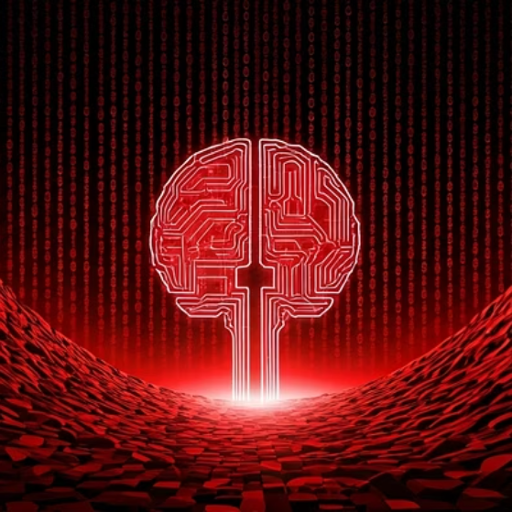




Data Collection & Processing
Public Datasets
Preprocessing
Privacy Measures
GoEmotions (58K Reddit comments), EmotionStimulus Dataset
Text cleaning, tokenization, addressing class imbalance
Anonymized user IDs, no PII stored
Data hashing and secure key management
Notes:
1.7.2013
8
‹#›

Slide 9



Methodology & Algorithm Design
Input Capture
1
Users enter text or voice data via a web/mobile interface.
2
NLP-Based Emotion Detection
Use a fine-tuned transformer (DistilBERT/RoBERTa) for classification.
Emotion Mapping
3
Map detected emotion to targeted, pre-curated wellness content.
4
Content Recommendation
Deliver personalized mindfulness or journaling prompts.
Feedback Loop
5
Capture user feedback to refine recommendations.
Transformer-based encoder → Softmax output layer
Rule-based mapping initially, with future plans for reinforcement learning
Programming Language & Tools
Language: Python
NLP Frameworks: Hugging Face Transformers, SpaCy
ML Libraries: TensorFlow, PyTorch
API Tools: FastAPI
Notes:
1.7.2013
9
‹#›

Slide 10
Technology Stack & System Architecture
Tools Used
System Architecture
Data Handling: Pandas, NumPy
Microservices:
Databases: PostgreSQL, SQLite
Frontend (captures user input and shows recommendations)
API & Web Frameworks: FastAPI
API Gateway (routes requests)
Emotion Detection Service (NLP model inference)
Frontend: HTML/CSS, ReactJS (optional)
Recommendation Engine (maps emotion to intervention)
Deployment & Containerization: Docker, AWS EC2
Database Service (stores profiles and session logs)
Security: JWT-based authentication, HTTPS, data anonymization
Data Flow:
User input → API Gateway → Emotion Service → Recommendation Engine → User interface (with feedback logging)
Notes:
1.7.2013
10
‹#›

Slide 11


Output Generation & Analysis
Output Generation
Output Analysis
1
Detected Emotion
1
Stress/Anxiety Scores
Specific emotional state identified (e.g. "anxious")
Compare pre- and post-intervention using scales like GAD-7 or DASS-21
2
Explanation
Key words/phrases triggering the classification
2
Model Performance
Analyze precision, recall, F1-score, and confusion matrix
3
Intervention
Recommended action (e.g. breathing exercise, journaling prompt)
3
Statistical Analysis
Apply t-tests, ANOVA or regression to identify trends
4
User Feedback
Thumbs-up/down or star ratings from the user
Notes:
1.7.2013
11
‹#›

Slide 12
Handling Abnormal Cases
Detection
1
Identify misclassifications and intervention failures through automated monitoring
2
Analysis
Apply confusion matrices and examine error patterns to understand root causes
Refinement
3
Adjust model parameters and intervention rules based on error analysis
4
Validation
Test improvements against historical failure cases to confirm resolution
Notes:
1.7.2013
12
‹#›

Slide 13

Hypothesis Evaluation & Discussion
Hypothesis Evaluation
Our primary hypothesis (H1) focused on comparing stress and anxiety score reductions between a control group using a generic wellness app and a test group using our AI-powered assistant. Results indicate the AI assistant group demonstrated significantly greater improvement, achieving more than double the reduction in both anxiety (42% vs. 18%) and overall stress scores (47% vs. 22%).
For our technical performance hypothesis (H2), the emotion detection model achieved an F1-score of 0.89, surpassing our target of 0.85. This validates the effectiveness of our approach to emotion detection.
Key Discussion Points
1
Personalized Interventions
2
Abnormal Case Management
3
Scalability Challenges
The superior outcomes observed in the AI assistant group underscore the value of dynamic, personalized interventions compared to static content.
While handling ambiguous inputs and diverse linguistic expressions remains a challenge, our modular architecture allows for continuous expansion of capabilities.
Our robust error analysis and model refinement processes have proven effective in systematically addressing classification issues and enhancing overall performance.
These results highlight the efficacy of an AI-driven approach to mental wellness support. By integrating accurate emotion detection, personalized interventions, and continuous improvement, we deliver significantly enhanced outcomes for our users.
Notes:
1.7.2013
13
‹#›

Slide 14
Summary & Conclusions
In this study, we have presented a women-centric, AI-powered solution that leverages advanced natural language processing to deliver highly personalized mental wellness support. By dynamically adapting our interventions based on each user's unique emotional state and preferences, our distributed system approach not only meets the growing demand for accessible mental health resources, but also outperforms generic wellness applications.
We conclude that our innovative approach provides a robust and effective solution for addressing the mental health needs of women, with significant improvements in user stress and anxiety metrics as well as high technical performance of the underlying emotion detection model.
Notes:
1.7.2013
14
‹#›

Slide 15
Key Outcomes & Recommendations
Key Outcomes
Recommendations
1
Significant improvements in user stress/anxiety metrics
1
Expand dataset for increased diversity and robustness
2
Robust technical performance with high model F1-scores
2
Integrate voice inputs and explore mobile/wearable tech
3
Conduct long-term, large-scale clinical trials
4
Enhance recommendation engine with reinforcement learning
Notes:
1.7.2013
15
‹#›

